Slide 1
Single Deep CNN Features to Detect Neurodegenerative Diseases: Alzheimer, Parkinson and Dementia

Slide 2

Capstone Project (CSE 498)
Supervised by
Mr. M M Fazle Rabbi Assistant Professor Department of CSE Bangladesh University of Business and Technology (BUBT)
Submitted by
Mohammad Sabbir Ahmed | 17183103004
Syeda Nowshin Ibnat | 17183103020
Rakibul Ahasan | 17183103022
Sk. Abu Hanif | 17183103043
Nusrat Jahan Anka | 17183103008
Intake: 39(1), Dept. of CSE, BUBT
Presented Date: 15-12-2022

Slide 3
01.
07.
13.
02.
08.
14.
03.
09.
15.
04.
10.
16.
05.
11.
17.
06.
12.
Contents
Problem Analysis
Introduction
Ethics
Problem Statement
Research Flow
Impact of Society
Sustainability
Problem Background
Research Methodology
Motivation
Proposed Model
Conclusion
Why did we choose ResNet-50 model?
Objectives
Reference
Some challenges in our project
Literature Review

Slide 4
Introduction
Neurodegenerative diseases occur when nerve cells in the brain or peripheral nervous system lose function over time and ultimately die. Alzheimer's disease, Parkinson's disease, and dementia are most common examples of neurodegenerative disease. We can detect these three diseases with a single DL model through our work.

Slide 5
Problem Statement
Identifying neurodegenerative diseases with proper explanation using one model is quite challenging.

Slide 6
Problem Background
The present neurodegenerative diseases detection system only detects one disease.
Identifying neurodegenerative diseases is a deadly problem that needs to be solved.
Due to the similarities in disease phenotypes, accurate detection of neurodegenerative diseases, including the context behind the detection is problematic.

Slide 7






Motivation
Detect the disease in early stage.
Detect three diseases with a single model.
To reduce wasting time & cost.

Slide 8
Objectives
Identifying present difficulty to work with neuroimaging data.
Build a DL model to detect three Neurodegenerative
Diseases named Alzheimer's, Parkinson's and Dementia.
Get decent accuracy using a suitable MRI dataset.
Comparing the existing architectures with the proposed
work for neurodegenerative diseases detection.

Slide 9
Literature Review
Author | Disease | Model | Dataset | Accuracy
M. Biswas et al. [1] | AD | Deep CNN | Kaggle | 99.38%
A. W. Salehi et al. [2] | AD | CNN | ADNI | 99%
Y. AbdulAzeem et al. [3] | AD | CNN based end-to-end | ADNI | 97.5%
J. A. Akhila et al. [4] | DD | Feed Forward ANN | OASIS | 97.5%
A. Bidani et al. [5] | DD | Deep CNN + TL | OASIS | 81.94%
S. Murugan et al. [6] | DD | DEMNET | ADNI | 95.23%
W. Wang et al. [7] | PD | LeNet-5 | PPMI | 97.92%
S. Sivaranjini et al. [8] | PD | AlexNet | PPMI | 88.9%

Slide 10




Problem Analysis
The existing approaches can detect one disease at a time.
Costly and time consuming.
Accuracy rate is not satisfactory.

Slide 11
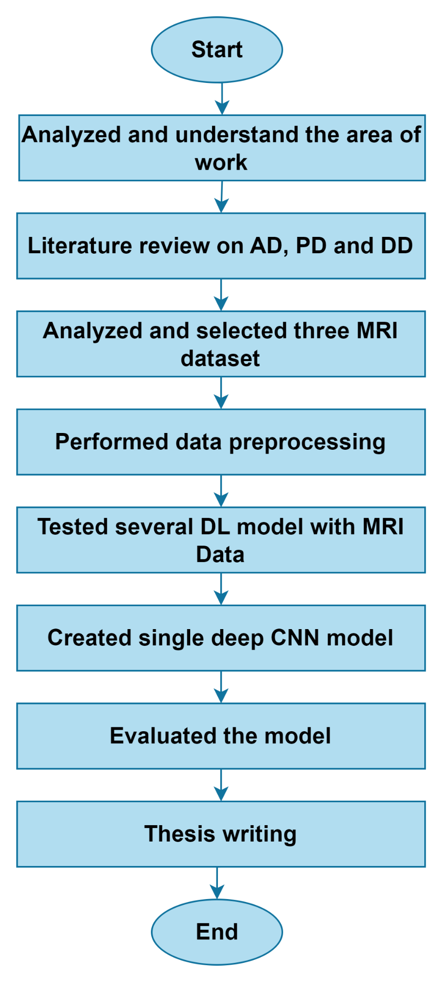
Research Flow

Slide 12
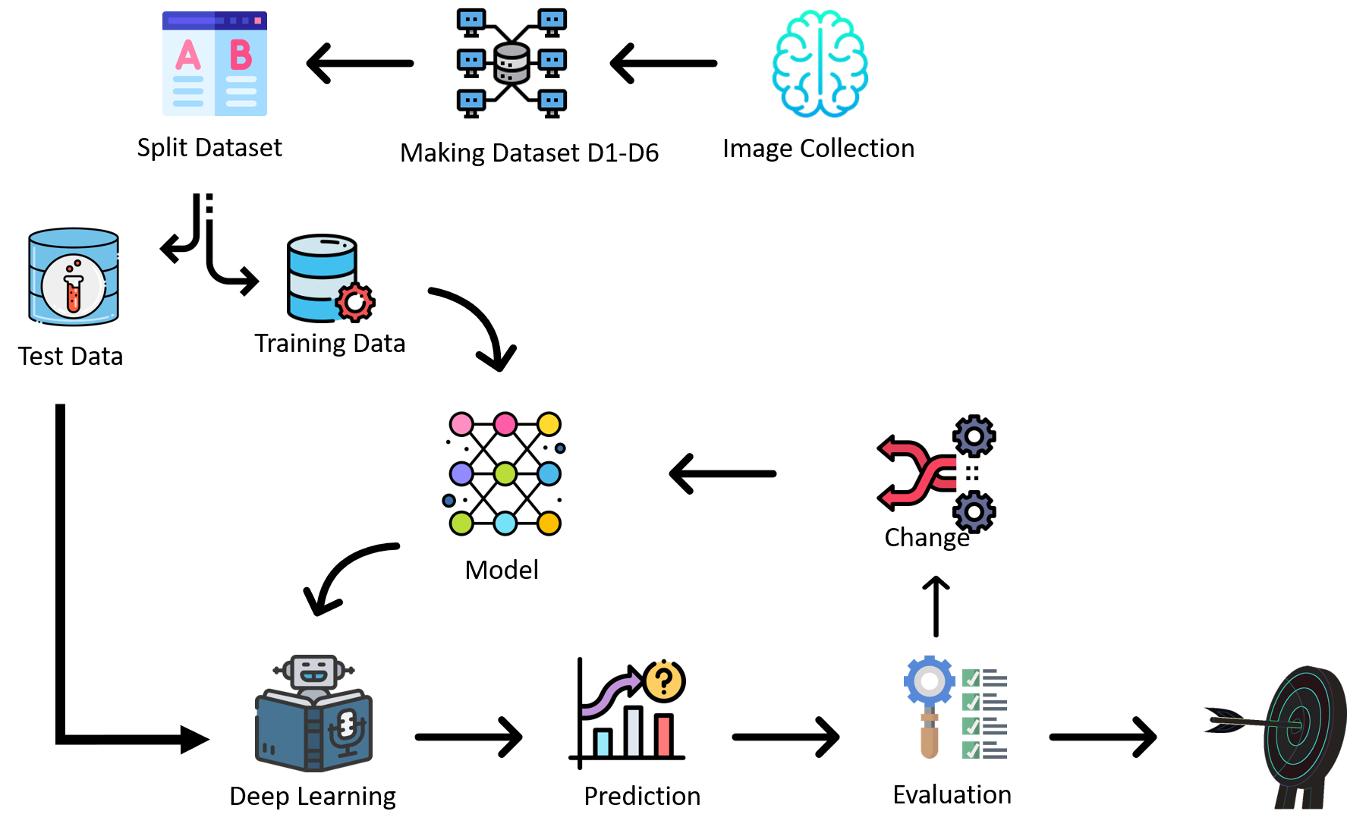
Research Methodology

Slide 13
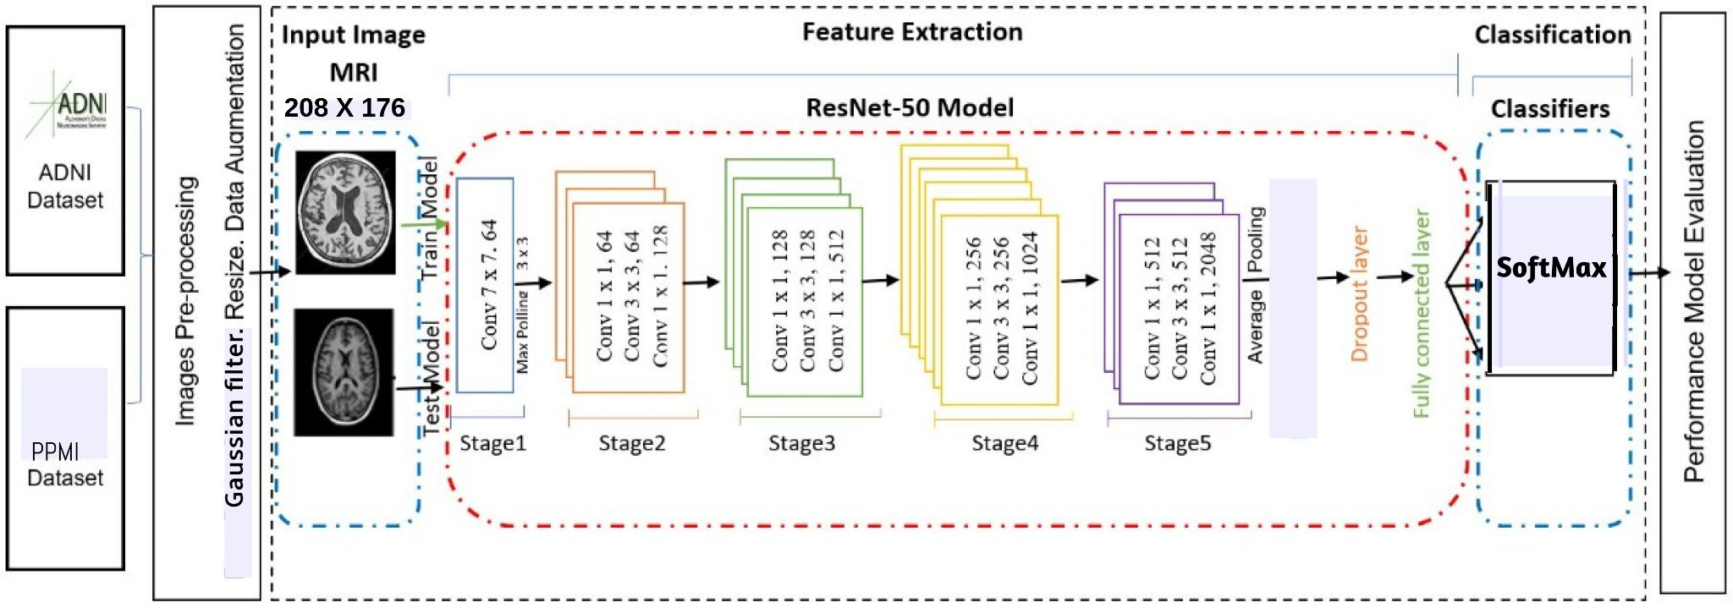
Proposed Model

Slide 14
Why did we choose the resnet50 model?
ResNet-50 is a 50-layer convolutional neural network (48 convolutional layers, one MaxPool layer, and one average pool layer).
ResNet-50 has fewer filters and is less complex than a VGGNet.
ResNet-50 is significantly faster than a Vgg-19 Network with 19.6 billion FLOPs.
ResNet-50 model pre-trained machine learning model.
ResNet-50 model helps achieve higher performance even if the model is trained on a smaller dataset.

Slide 15
Some challenges in our project
Converting all disease images to the same format.
Finding a good model.
ResNet50 model arise an overfitting problem.

Slide 16
Ethics
For our work we got our datasets from Kaggle, PPMI & OASIS. Our collected datasets are open source. From their written description these datasets were approved to show openly. In that case, we can say we didn’t break any law or regulation.

Slide 17
Impact of Society
It is essential in order to treat patients at an early stage.
It can also be used as a tool for raising awareness.

Slide 18
Sustainability
From previous works obtaining highest result we took inspiration and made a decision of using Deep Learning to get better result.
Through our proposed approach we can detect three diseases which wasn’t been done yet so with huge hope, we think our work can fulfill the sustainability.

Slide 19
Conclusion
In our society, there are a significant number of senior persons who suffer from neurodegenerative diseases. Through this work, we can detect three diseases with a single model which will be beneficial for medical professionals & an extensive field of research.

Slide 20
Reference
[1] M. Biswas, M. K. Mahbub, and M. A. M. Miah, “An Enhanced Deep Convolution Neural Network Model to Diagnose Alzheimer’s Disease Using Brain Magnetic Resonance Imaging,” Commun. Comput. Inf. Sci., vol. 1576 CCIS, pp. 42–52, 2022, doi: 10.1007/978-3-031-07005-1_5.
[2] A. W. Salehi, P. Baglat, B. B. Sharma, G. Gupta, and A. Upadhya, “A CNN Model: Earlier Diagnosis and Classification of Alzheimer Disease using MRI,” Proc. - Int. Conf. Smart Electron. Commun. ICOSEC 2020, no. Icosec, pp. 156–161, 2020, doi: 10.1109/ICOSEC49089.2020.9215402.

Slide 21
Reference cont.
[3] Y. AbdulAzeem, W. M. Bahgat, and M. Badawy, “A CNN based framework for classification of Alzheimer’s disease,” Neural Comput. Appl., vol. 33, no. 16, pp. 10415–10428, 2021, doi: 10.1007/s00521-021-05799-w.
[4] J. A. Akhila, C. Markose, and R. P. Aneesh, “Feature extraction and classification of Dementia with neural network,” 2017 Int. Conf. Intell. Comput. Instrum. Control Technol. ICICICT 2017, vol. 2018-Janua, pp. 1446–1450, 2017, doi: 10.1109/ICICICT1.2017.8342782.

Slide 22
Reference cont.
[5] A. Bidani and M. S. Gouider, “Dementia Detection and Classi fi cation from MRI Images Using Deep Neural Networks and Transfer Learning,” vol. 1, pp. 925–933, doi: 10.1007/978-3-030-20521-8.
[6] S. Murugan, C. Venkatesan, M. G. Sumithra, S. Member, and X. Gao, “DEMNET : A Deep Learning Model for Early Diagnosis of Alzheimer Diseases and Dementia From MR Images,” IEEE Access, vol. 9, pp. 90319–90329, 2021, doi: 10.1109/ACCESS.2021.3090474.

Slide 23
Reference cont.
[7] W. Wang, J. Lee, F. Harrou, and Y. Sun, “Early Detection of Parkinson’s Disease Using Deep Learning and Machine Learning,” IEEE Access, vol. 8, pp. 147635–147646, 2020, doi: 10.1109/ACCESS.2020.3016062.
[8] S. Sivaranjini and C. M. Sujatha, “Deep learning based diagnosis of Parkinson ’ s disease using convolutional neural network,” 2019, [Online]. Available: https://doi.org/10.1007/s11042-019-7469-8.

Slide 24
Thank You

